Slide 1
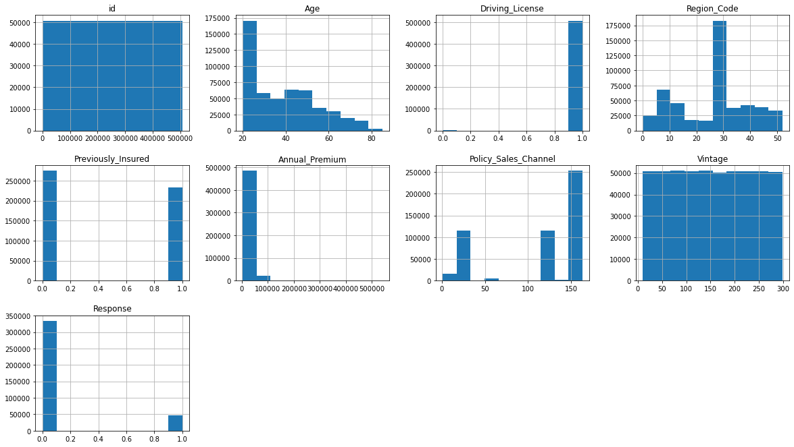
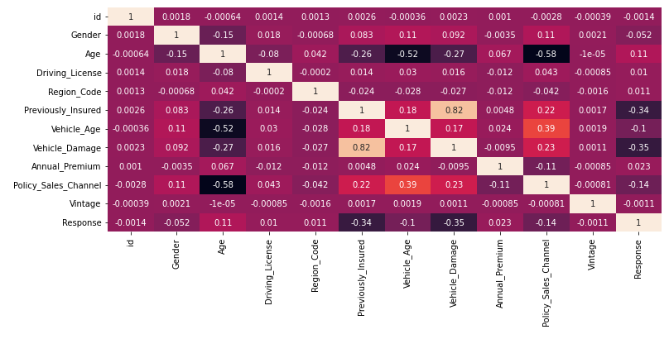
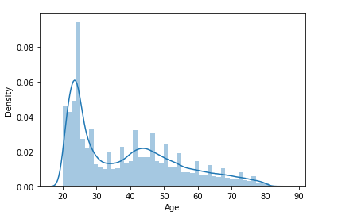
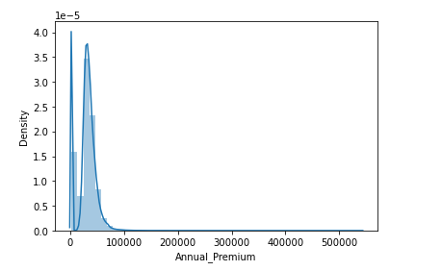
Cross Prediction Analysis
Characteristics of dataset:
No Null Values
Data types -
Numerical: 'id’, 'Age’, 'Driving_License’, 'Region_Code', 'Previously_Insured’, 'Annual_Premium', Policy_Sales_Channel’, 'Vintage’, 'Response’
Categorical: 'Gender', 'Vehicle_Age', 'Vehicle_Damage’
First look insights of data
Age and Annual premium are skewed
Driving license doesn't add any value, can be dropped
Gender, Vehicle age, damage, previously insured to be encoded
Age, Vintage and Annual Premium can be binned
After binning, vehicle_Damage’, 'Vehicle_Age’, 'Age','Gender’, 'Previously_Insured’, 'Vintage’, 'Annual_Premium’ can be one hot encoded

Slide 2
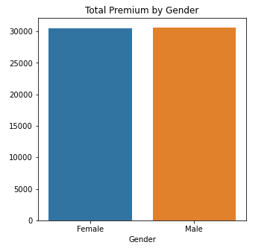
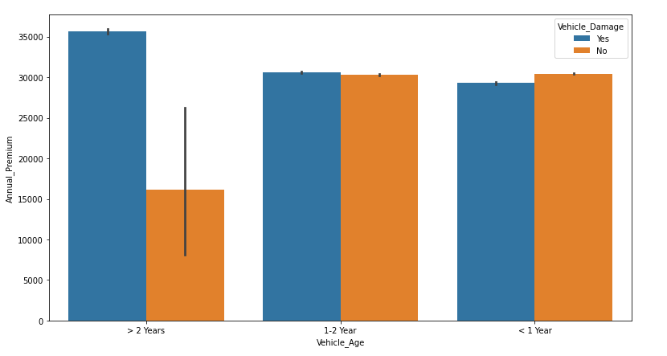
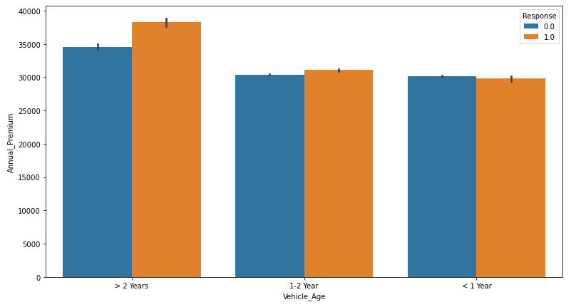
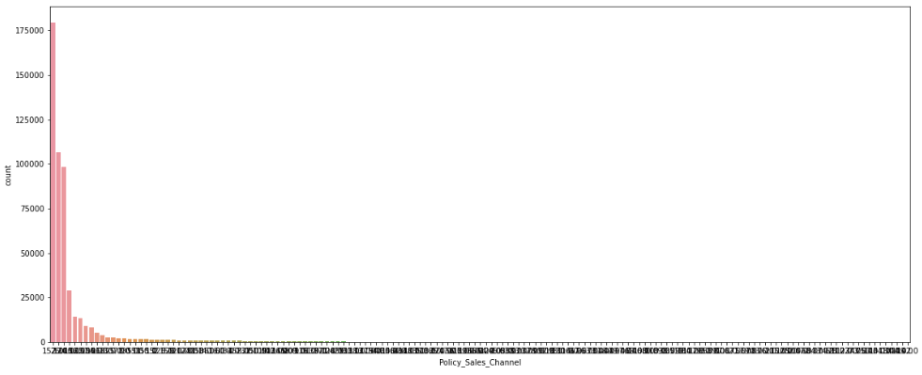
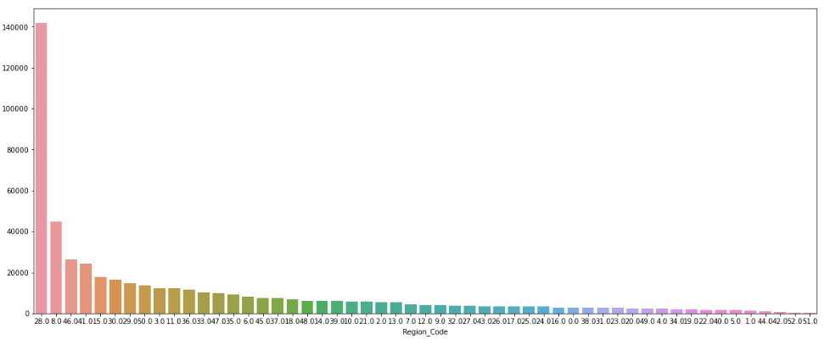
Story board
Story
2
4. 5. 6
Male population opts for slightly high annual premium
People who own vehicle > 2 years with damage pays for high annual premium
Damaged Vehicle with 1-2 years old and who are insured already are more likely to buy insurance again
Generally people do not prefer purchasing high premium
Only few policy channels get more customers
Region code 28 gets the more customers

Slide 3
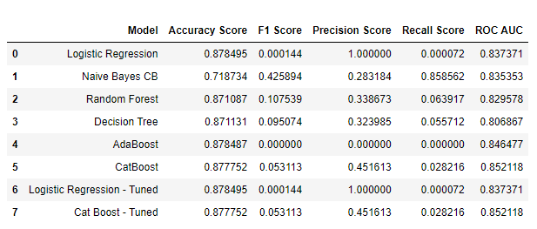
Approach
Result
Data Cleaning:
Convert all the categorical values to numerical values for some features
Feature Engineering:
Binning/Discretization –
Pick out the features to perform data binning
Age
Vintage
Annual Premium
Find the best depth of tree to perform binning using decision tree classifier
Check if the bin’s relationship with target is linear
Find min and max of bin categories
Label the bins into a new discrete column and assign numerical values to each bins
Encoding –
Encode the features with less unique values using one hot encoding
Remove the original values
Model Selection: Try running the classifier models
Error Metrics: ROC AUC for all models
Hyper parameter tuning: Use Grid search for choosing the right parameters
Summary: Load all the Error metrics to a dataframe for better decision making to choose right model
Best Model: After checking the ROC AUC for all models, it is evident that CATBOOST works well for this model, both with and without hypertuning parameters, giving a final result of 85.2 for Test dataset

